Slide 1

Forecasting Financial Markets: Stock Price Prediction Using Machine Learning

Slide 2
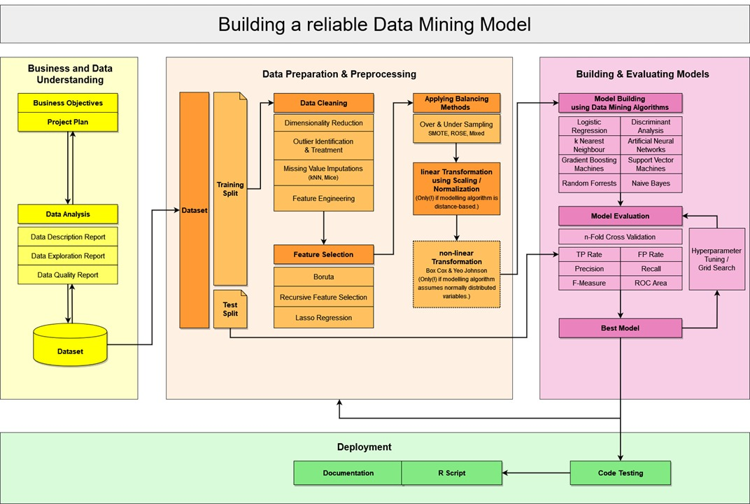

Slide 3
Table of contents
01
02
03
04
05
Business
Understanding
Data Extraction and Dataset generation
Data Preparation and pre-processing
Model Building
Model
Evaluation
Notes:
breif

Slide 4
01
Business Understanding

Slide 5
Objective
This project aims to bridge the gap between theory and practice by providing a comprehensive tutorial on building a machine learning model for stock price prediction.
Scope
Introduction to the fundamentals of financial markets and stock price prediction.
Exploration of relevant datasets, including historical stock prices, trading volumes, and other financial indicators.
Preprocessing and feature engineering techniques to prepare data for model training.
Selection and implementation of suitable machine learning algorithms, such as regression, time series forecasting, and ensemble methods.
Evaluation of model performance using appropriate metrics and validation techniques.
Interpretation of results and insights gained from the predictive model.
Practical demonstrations and hands-on exercises to reinforce learning objectives.

Slide 6
02
Data Extraction and Dataset generation
Transforming publicly available stock price information to ML datasets

Slide 7
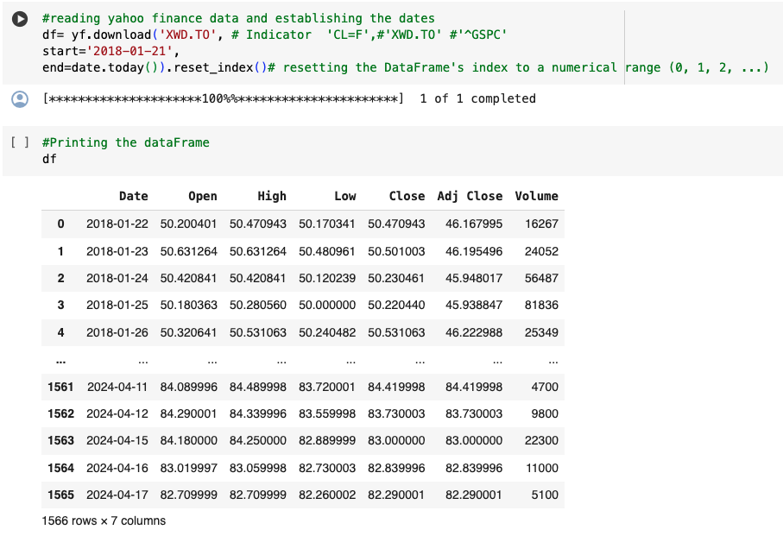
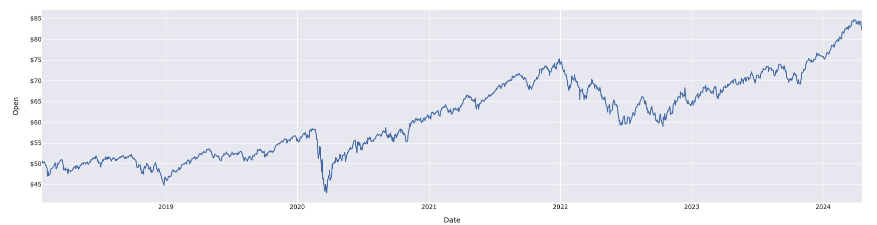
Raw Data from Yahoo Finance
Updates every run (Flexible Start Date)
Apply on different stock indexes
Observing Open Price trend
Generate financial indicators (features) and target variable
7

Slide 8
Raw Data – MSCI
MSCI stands for Morgan Stanley Capital International. It is a leading provider of global benchmark indices and related investment tools and services.
Indices are widely used by institutional investors, mutual funds, ETFs, and other financial products to track the performance of specific markets or sectors.
MSCI is a key player in the financial industry, providing essential tools and benchmarks that help investors make informed decisions and manage their portfolios effectively. Its products and services are trusted by financial professionals worldwide.
import yfinance as yf library provides the access to the historic data from yahoo finance.

Slide 9
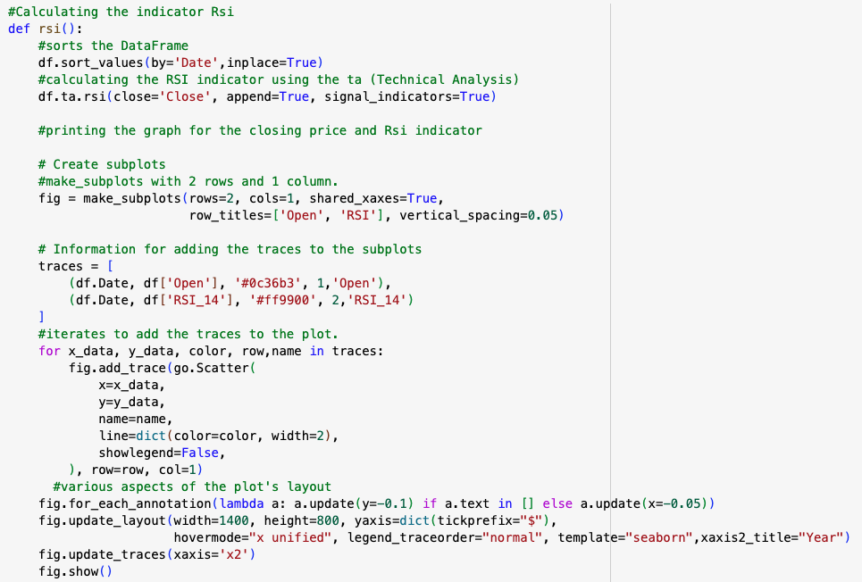
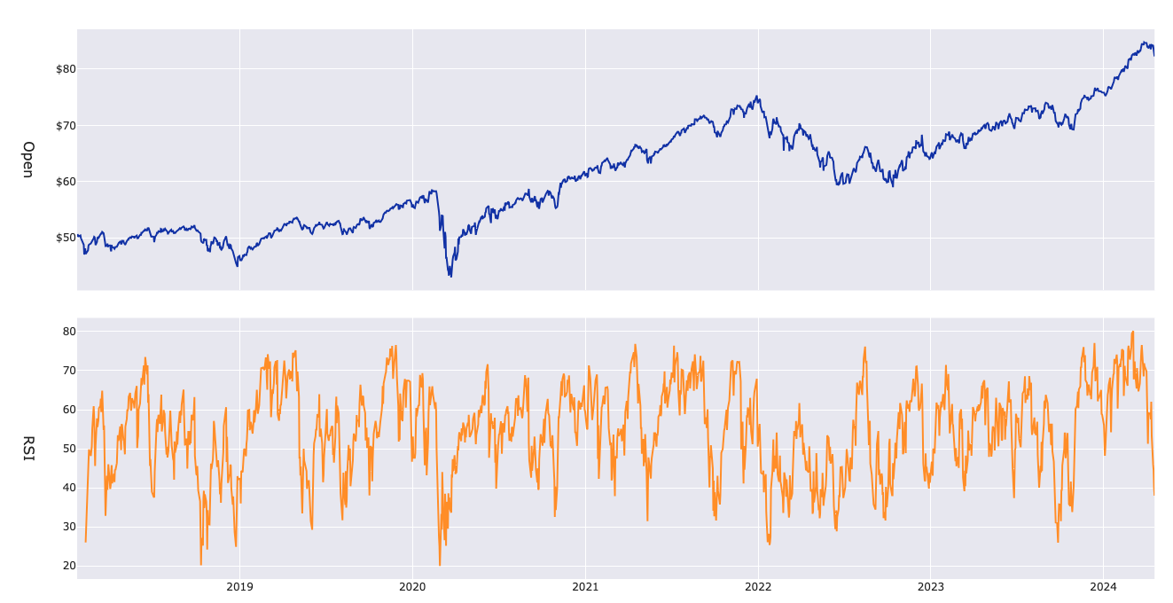
Dataset Generation – Features
Technical Analysis: Price-Based Indicators
Generating financial indicators involves transforming raw financial data into meaningful features that capture important aspects of a company's performance and market dynamics. These indicators become features in the machine learning model
import pandas_ta as ta – can extends pandas with technical analysis and feature calculation
We calculated the following indicators and their corresponding charts:
RSI
MACD
Moving Average
Stochastic oscillator
Exponential moving average
Bollinger bands
Ichimoku cloud
Standard deviation

Slide 10
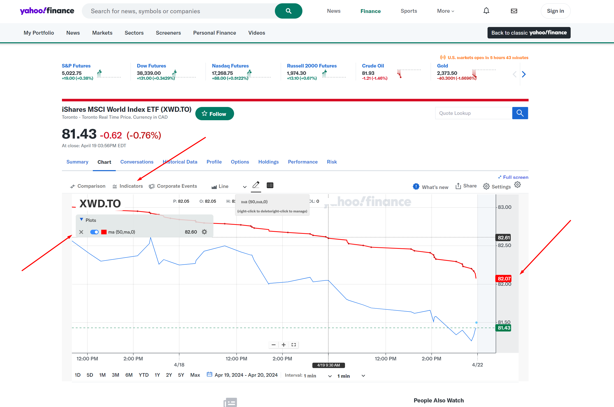
Dataset Generation – Features (Double-Checking)
After calculating each financial indicator, we should compare the values with Yahoo finance to double check if the indicators have been calculated correctly. Double checking a few dates will suffice
https://finance.yahoo.com/recent-quotes/

Slide 11
Dataset Generation – Target Variable
Target variable is calculated based on the difference of OPEN Price between the current and the previous day.
(We changed from close price to enable back-testing. After the model predicts decision, we use the open price on the same day to buy, or to sell. )
Threshold Definition:
Buy: a positive percentage threshold above which the potential profit is considered significant enough to warrant a buy recommendation.
Hold: a neutral zone where the profit is not significant enough to justify buying or selling.
Sell: a negative percentage threshold below which the potential loss is considered significant enough to recommend selling the stock.
Labeling:
Based on our threshold definition, we generate labels for hold (0), sell (1), buy (2), which are the target variables.

Slide 12
Dataset Generation – Target Variable - Definition
- By defining thresholds for daily changes, you can categorize days into actionable signals:
- Buy: When the daily change is significantly negative (e.g., a drop of more than 1%), it indicate a buying opportunity if the price is considered undervalued.
- Sell: When the daily change is significantly positive (e.g., a rise of more than 1%), it indicate a selling opportunity if the price is considered overvalued.
- Hold: When the daily change is within a neutral range, indicating no significant price movement, a "hold" decision is often appropriate

Slide 13
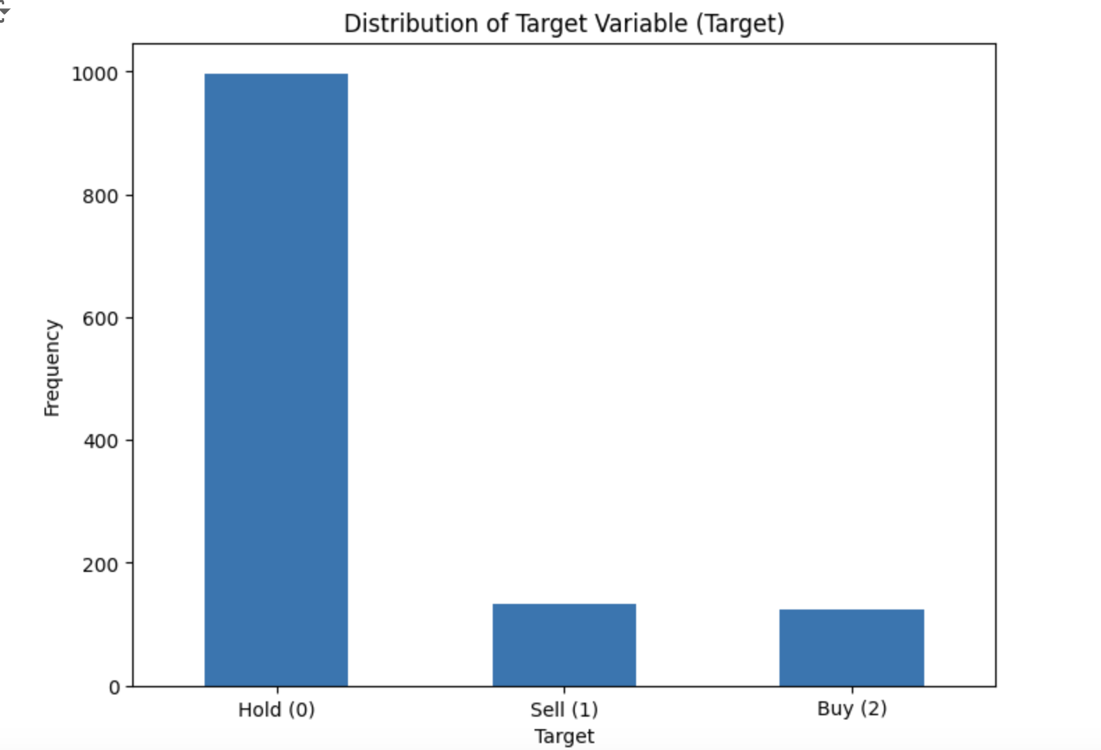
Dataset Generation – EDA
To see, the characteristics, uncover patterns and main goal is to understand the data before applying any data processing techniques and building models.
Distribution of target variable: Get a sense of the frequency distribution of the target variable.
This lets us know if balancing method is required before we apply model building

Slide 14
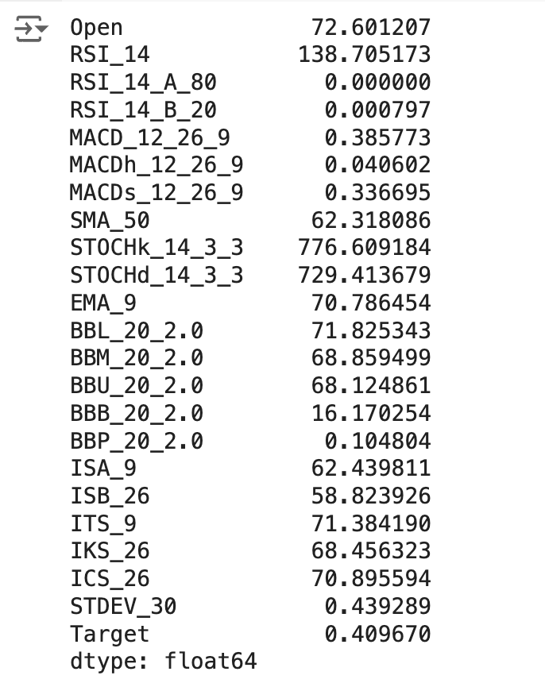
Dataset Generation – Variance
Feature Variance: A reference to rough dimensionality reduction, as features with low variance provide little information to model building. Based on variance, we arbitrarily decide on the threshold to drop features with variance below the threshold
*Open Price is included here for back-testing later, not used as a feature in modeling

Slide 15
03
Data Preparation & Preprocessing

Slide 16
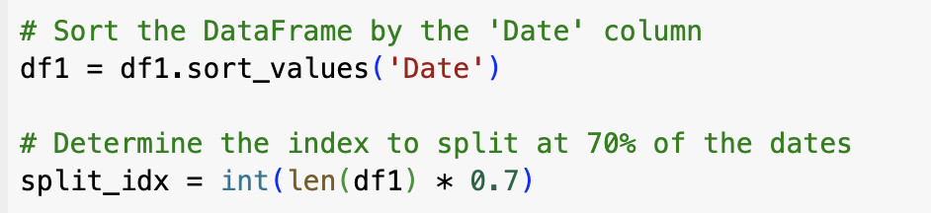
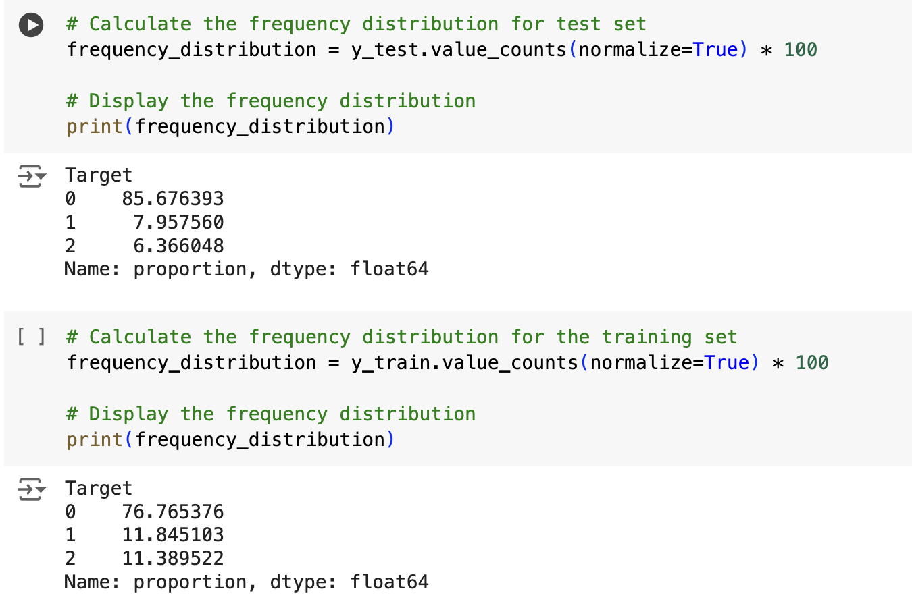
Dataset Preparation: Train – Test Split
Train – Test ratio: 70% - 30%
Splitting in chronological order:
We sort the data by date, the training dataset contains the earliest 70% and the test dataset contains the latest 30%
Not stratified sampling, the ratio of buy/hold/sell is not identical in training and test datasets.

Slide 17
Why not stratified sampling?
Stratified random sampling is not possible because this data is having time series
past data values can inference future predictions
breaking the temporal order can disrupt these dependencies and leading to inaccurate modeling and forecasting
Time series data often exhibit trends and seasonal patterns.
Stratified splitting can mix different parts of these patterns,
making it harder for models to learn the underlying structure of the data.

Slide 18
Rough Dimensionality Reduction
Drop Features with Variance below the threshold
Threshold = 0.1
Features 21 -> 18
Drop Features with Missing Values above the threshold
why? -many missing values does not contribute to model building process as they are noice in the data
Threshold = 90%
Features 18 -> 18
Outlier Identification and Treatment: 3s-rule
why? - out of boundary values can drastically impact on skewness of the data
- leading to misleading results on evaluation phase
- also, many machine learning algorithms and data processing algorithms are sensitive to outliers like PCA and KNN

Slide 19
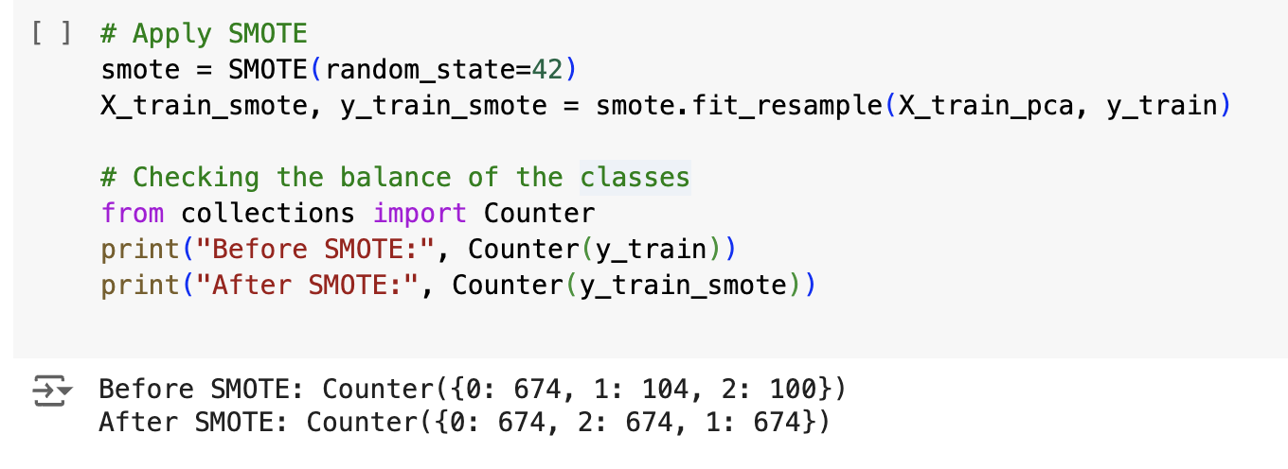
Data Preprocessing
Missing Value Imputation : KNN
why?
- to ensure dataset is complete and usable for machine learning and model building
- missing data can lead to biased results
(Can also be done by Boruta feature selection – same results)
PCA - feature reduction is dimentionality reduction
- process of reducing the number of input features in a dataset while retaining as much relevant information as possible.
- PCA is a powerful technique for reducing feature dimensions by transforming the original features into principal components that capture the maximum variance.
- This helps in mitigating issues related to high dimensionality and improving the overall effectiveness of data analysis and machine learning models.
Features 18 -> 4
Data Balancing: SMOTE

Slide 20
04
Modeling

Slide 21
Model | Characteristics | References
Naive Bayes | Model based on Bayes theorem. It works well with features that are categorical. | https://scikit-learn.org/stable/modules/naive_bayes.html
Random Forest | Ensemble method based on several decision tree classifiers. Can handle non-linear relationships. | https://scikit-learn.org/stable/modules/generated/sklearn.ensemble.RandomForestClassifier.html
Decision Tree | Easy to understand and visualize. It is capable of handling both numerical and categorical data. | https://scikit-learn.org/stable/modules/tree.html
KNN | Data is classified based on its nearest neighbors. Sensitive to the number of neighbors selected. Distance-based algorithm. | https://scikit-learn.org/stable/modules/generated/sklearn.neighbors.KNeighborsClassifier.html
SVC | It is a supervised learning methods used for classification and regression. Data is separated into hyperplanes. | https://scikit-learn.org/stable/modules/svm.html#svm https://scikit-learn.org/stable/modules/generated/sklearn.svm.SVC.html
Xgboost | Decision trees are used to build the gradient boosting algorithm. Efficient and quick. Combines many weak learners to make a strong model. | https://towardsdatascience.com/getting-started-with-xgboost-in-scikit-learn-f69f5f470a97 https://campus.datacamp.com/courses/extreme-gradient-boosting-with-xgboost/classification-with-xgboost?ex=4

Slide 22
05
Evaluation

Slide 23
Accuracy
The accuracy of 60-70% in financial prediction projects is relatively common due to the inherent complexity and unpredictability of financial markets.
These markets are influenced by numerous unpredictable factors such as geopolitical events, economic news, and investor sentiment, leading to significant noise. Additionally, challenges like data quality and quantity, the difficulty of feature engineering, risks of overfitting and underfitting, market regime changes, non-stationary data, and the irrationality of human behavior contribute to this moderate level of accuracy.
Despite sophisticated models and techniques, capturing all the nuances of financial markets remains a significant challenge, thus limiting prediction accuracy.

Slide 24
Evaluation
Precision - The proportion of true positive predictions among all positive predictions made by the model. It is a measure of the accuracy of the positive predictions.
Recall - The proportion of true positive predictions among all actual positive instances in the data. It indicates how well the model identifies all relevant instances.
F1-Score -The harmonic mean of precision and recall.
It provides a balance between precision and recall. Higher values indicate a better balance between the two.

Slide 25
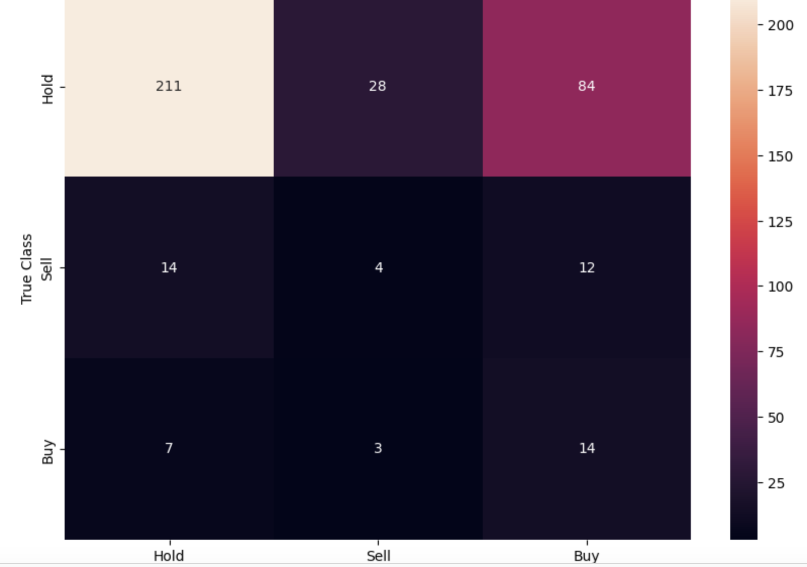
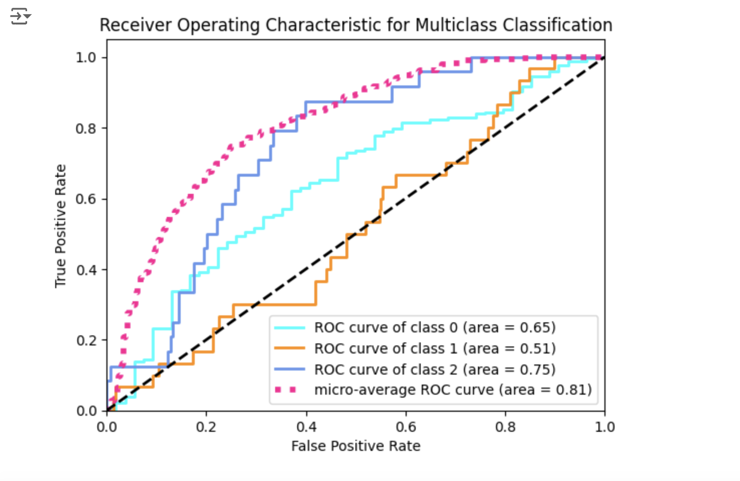
F1 Score, Confusion Matrix, ROC Curve
Model |  | F1 Score
Ensemble Learning | 0 - Hold | 0.83
Random Forest | 0 - Hold | 0.81
XGBOOST | 0 - Hold | 0.76
AdaBoost | 0 - Hold | 0.75
Decision Tree | 0 - Hold | 0.68
KNN | 0 - Hold | 0.67
Model |  | F1 Score
AdaBoost | 1 - Sell | 0.15
XGBOOST | 1 - Sell | 0.12
KNN | 1 - Sell | 0.11
Random Forest | 1 - Sell | 0.09
Ensemble Learning | 1 - Sell | 0.07
Decision Tree | 1 - Sell | 0.05
Model |  | F1 Score
XGBOOST | 2 - Buy | 0.21
AdaBoost | 2 - Buy | 0.21
Decision Tree | 2 - Buy | 0.19
Ensemble Learning | 2 - Buy | 0.18
Random Forest | 2 - Buy | 0.16
KNN | 2 - Buy | 0.14
We chose XGBOOST to run back-testing
Among all tried models, XGBOOST performed well

Slide 26
Evaluation
K – fold: K-Fold Cross-Validation is a technique used to assess the performance of a model by dividing the data into k sub folds. The model is trained on k folds and tested on remaining folds.
Walk-Forward Analysis: Walk-Forward Analysis is a method used specifically for time series forecasting, where the model is trained on a rolling window of historical data and tested on subsequent periods. The window moves forward in time, allowing the model to adapt to new data as it becomes available.
Backtesting: Backtesting involves testing a trading strategy or model on historical data to evaluate how well it would have performed in the past. It simulates the execution of the strategy using historical prices and other relevant data.

Slide 27
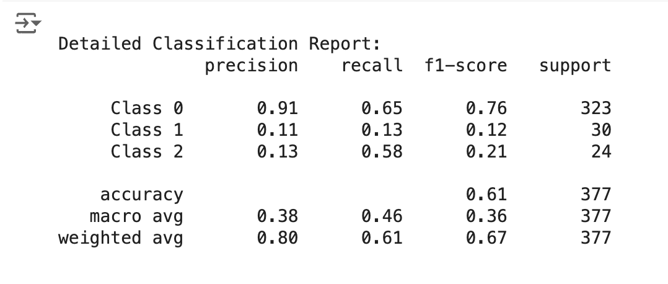
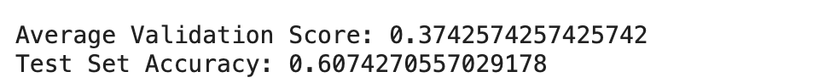
K-FOLD, Walk Forward
K-FOLD: suitable for general model evaluation
Walk Forward: ideal for time series model, commanly in finacial market

Slide 28
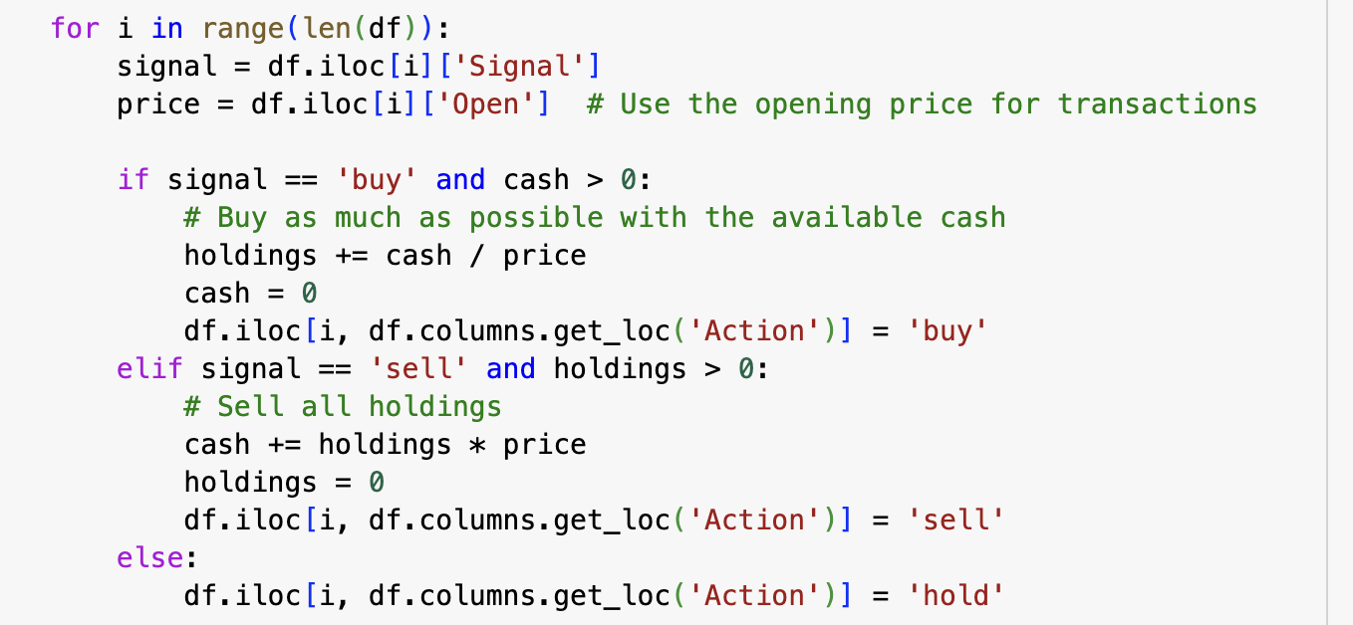
Backtesting – Stock Simulation
- Backtesting involves testing a trading strategy or model on historical data to evaluate how well it would have performed in the past. It simulates the execution of the strategy using historical prices and other relevant data.
- Primarily used in finance to evaluate trading strategies or investment models.
- Provides insights into the potential effectiveness of a strategy before live deployment.
Defining Trading Strategy:
Assumption made in this strategy:
Once the model predicts decision, we act on OPEN price on the same day
We only have one stock of interest in the portfolio
All-IN: We buy and sell as much as possible when the prediction says so and we have corresponding cash and holdings.

Slide 29
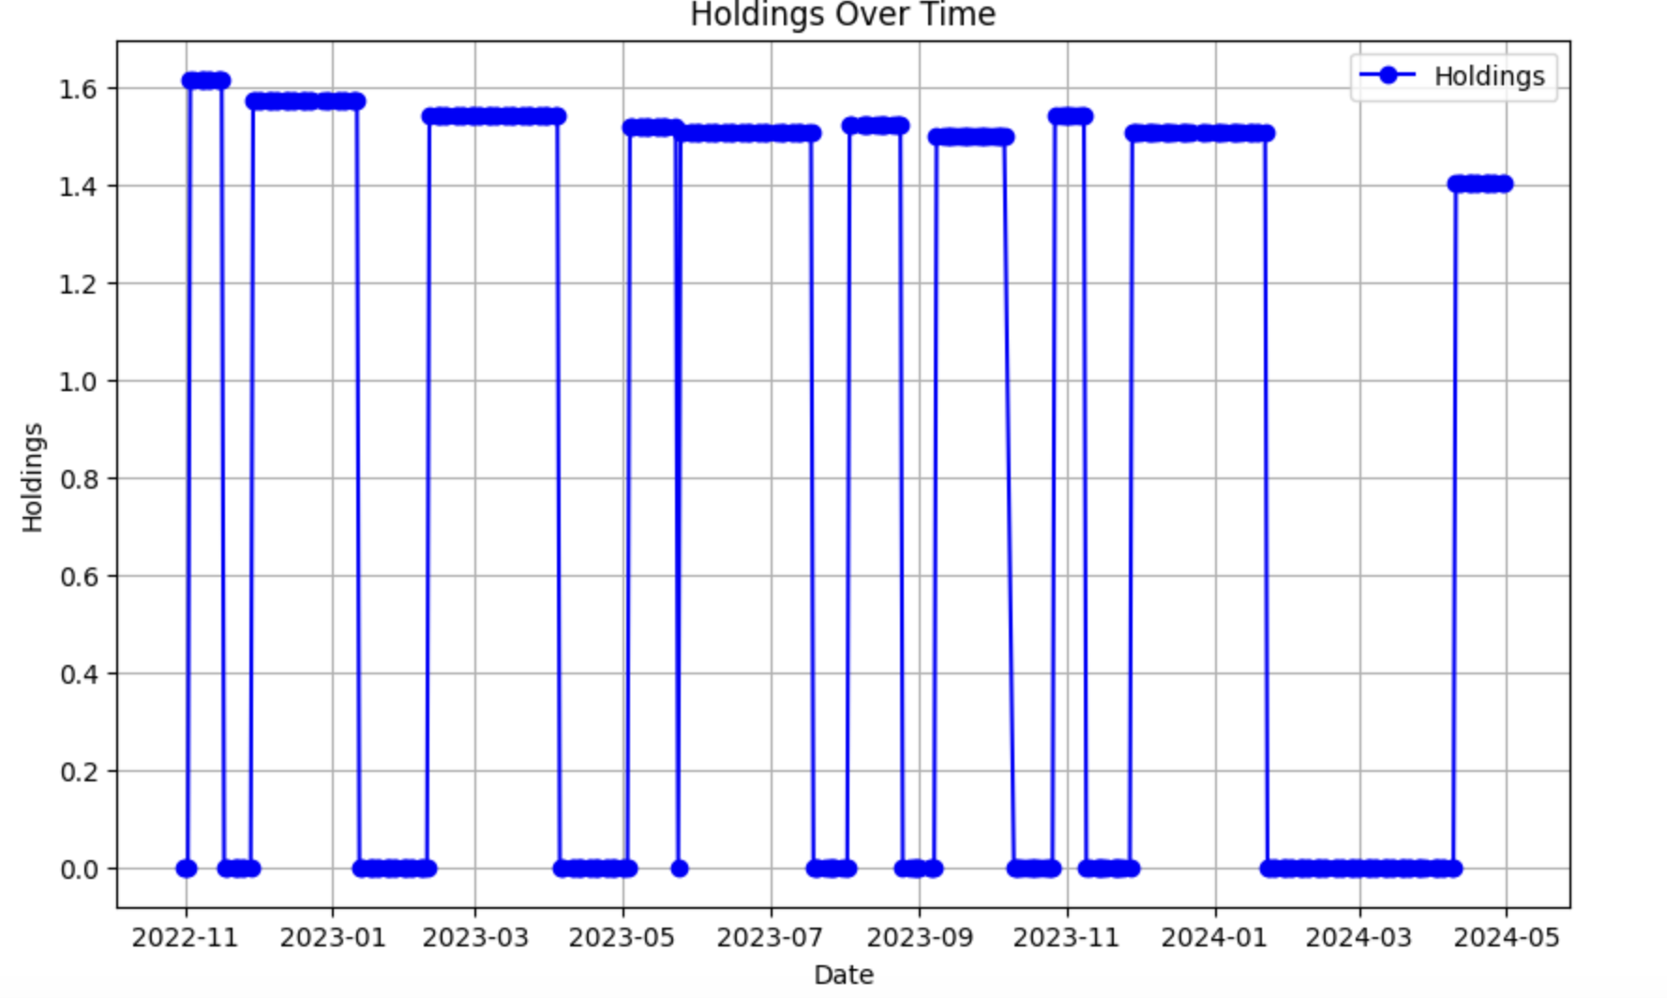
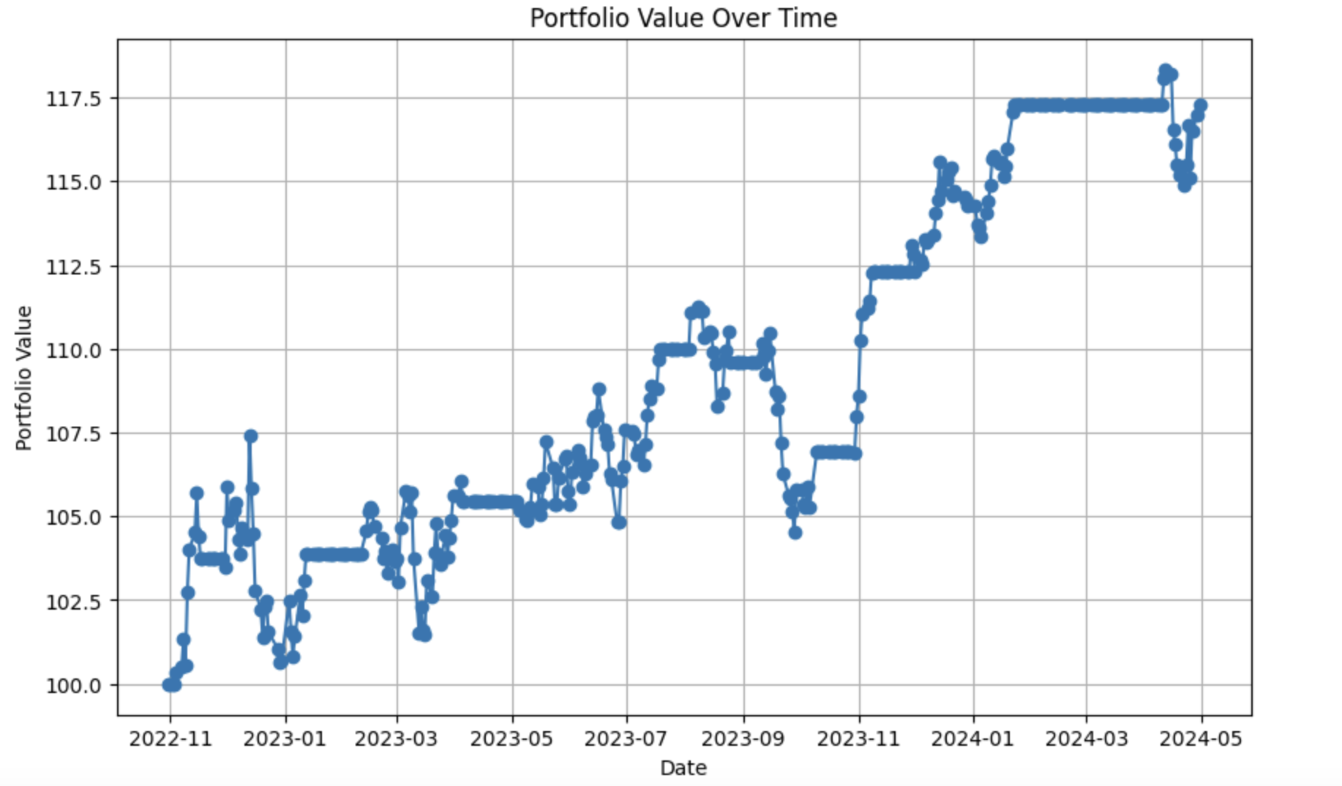
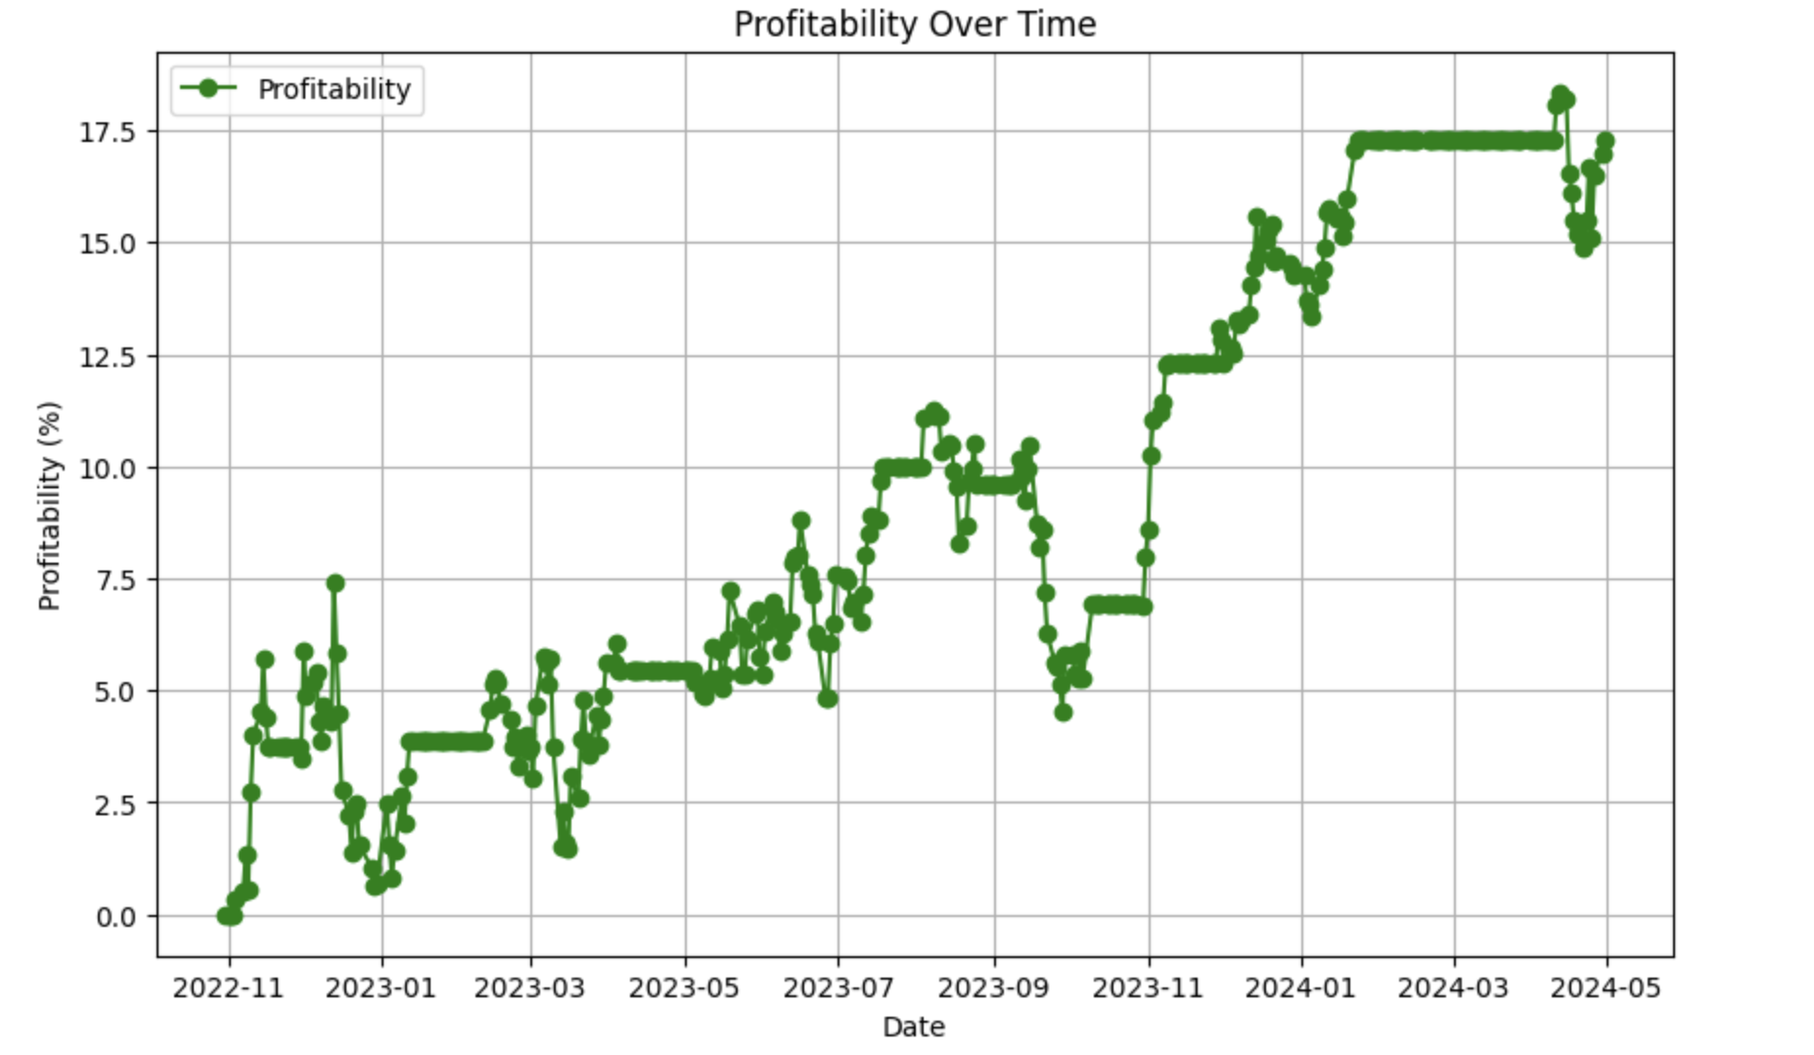
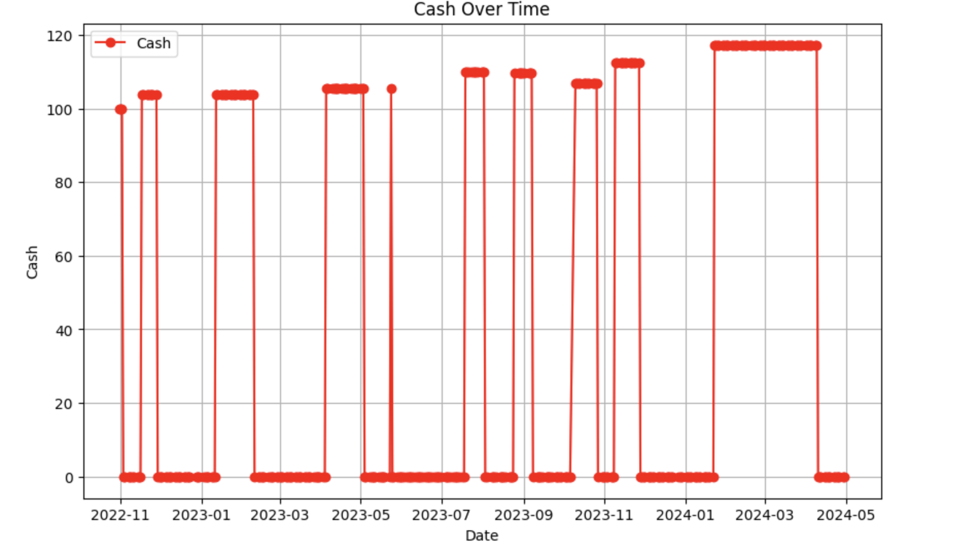
Backtesting Visualizations

